Slide 1
TE-06 Onboarding Project
Wireframe Design

Slide 2
Homepage
User must enter passcode before accessing the system
Homepage
TE-06 – Parking Helper System
Welcome to
TE-06 – Parking Helper System
Please enter the passcode:
Submit
Parking
Parking
Go to slide 2
Data insight
Data insight
Go to slide 2
The website is accessible after the passcode is entered

Slide 3
Parking Discovery Menu
Find real-time parking availability
Home
Destination
Parking area Distance Availabilty
Home
Click
Parking areas
Parking Page
Back
Parking Discovery
Parking Prediction
Fill “Destination”
Home
Destination
Monash University
Navigate button will open Google Map
Back
Parking area Distance Availabilty
Parking areas
Monash Sport 0.5 km 199
Woodside Building 1.5 km 29
N1 Building 2.5 km 300
Back

Slide 4
Parking Prediction Menu
Home
Predict parking availability
Destination
Parking area Address
Parking areas
Home
Back
Fill form “Destination”
Parking Page
Home
Parking Discovery
Destination
Monash University
Parking area Address
Parking areas
Parking Prediction
Please wait while system is updating…
Back
Home
Back
Destination
Monash University
Parking area Address
Monash Sport
Predicted Availability: 40
Congestion level: Medium
Parking areas
Monash Sport 40 Monash Dr
Woodside Building 1.5 km 29
(Pop up when one of the result is clicked)
N1 Building 2.5 km 300
Back

Slide 5
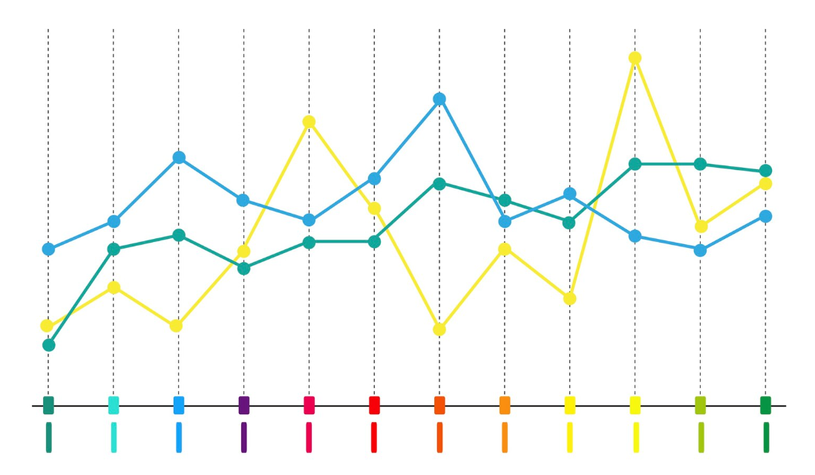
Home
Car Ownership
Registered vehicle
Home
Data Insight Page
Back
Year
Car Ownership
CBD Population Trend
Home
CBD Population Trends
Population
At least 5 data points
Back
Back
Year

